Slide 1
FC Continuing Education Series
SurveyCTO within the World Bank
Prepared by DIME Analytics
dimeanalytics@worldbank.org
Presented by Roshni Khincha
rkhincha@worldbank.org

Slide 2
About SurveyCTO
SurveyCTO is a powerful, field-tested platform that allows you to collect high-quality data using mobile phones, tablets, or computers—even when you're offline.
World Bank has an enterprise solution for SurveyCTO server – survey.wb.surveycto.com
Any data on this server is secure and encrypted
Internal server is cheaper than the commercial server
Quick(er) responses from the SurveyCTO support team
Managed by DIME Analytics
Upgraded to a new and improved version (v2.6) in early January

Slide 3
What is a server?
In SurveyCTO all questionnaires and data associated with a project sits on a server
Main purpose: Allows project team to communicate with the data and the field team to collect and upload that data
Not as technical as it sounds
For our purposes it is a just like a web page on the internet

Slide 4
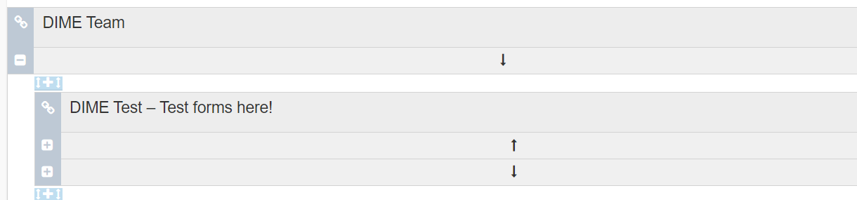
DIME Team on the server
All DIME team members have access to a server for free
The DIME Team server can be used to create and test survey forms
No data can be submitted on the test server

Slide 5
Requesting a server
When to request a server?
When the team is ready to start data collection
How much does a server cost?
$179 per month within the World Bank
How to request a server?
Request on eServices here (requires intranet access)
What to include in request?
Server name
Survey start and end date
Charge code
Submit a request as early as possible with a minimum 2 business days to activate server

Slide 6
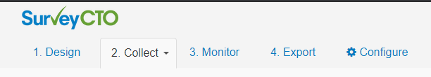
Interacting with the server
Admins listed on the eServices request have access to the server once it is set up
A server has the 5 tabs

Slide 7
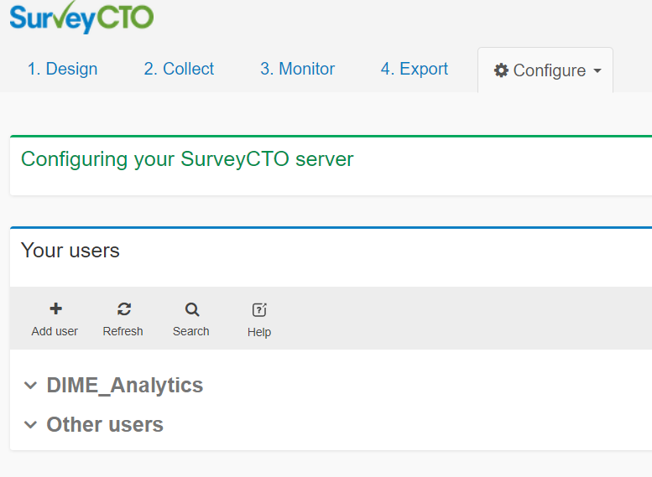
Accessing the server
Through the configure tab, the admin can
Add or remove any number of members
Members can be internal (i.e World Bank) or external
Define level of access for each member (through roles)

Slide 8
Your team on the server
The standard roles on each server are
Admin – complete access
Form & data manager – view and edit forms and data
Data manager – view and edit data
Enumerator – can only access forms on tablets for data collection
Custom roles can be create by DIME Analytics for
Different access permissions from the standard ones listed above
E.g. Data view access for government counterparts
Up to 4 roles per server
A user requires access to more than 1 server

Slide 9
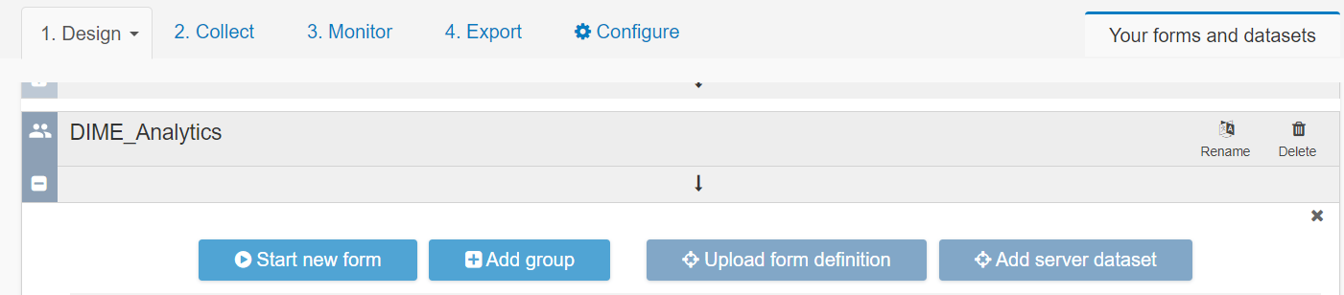
Setting up for data collection
Tab to use: Design
Design and upload survey forms to the server
Forms can be designed using
Form builder (click and point)
Excel
Another FC Continuing Education will cover designing survey SurveyCTO forms

Slide 10
Collecting data
Tab to use: Collect
2 modes of data collection
Offline
Through the SurveyCTO Collect app
Online
Link to survey on the Collect tab
Remember to turn on Anonymous access
Works on both, Android and iOS

Slide 11
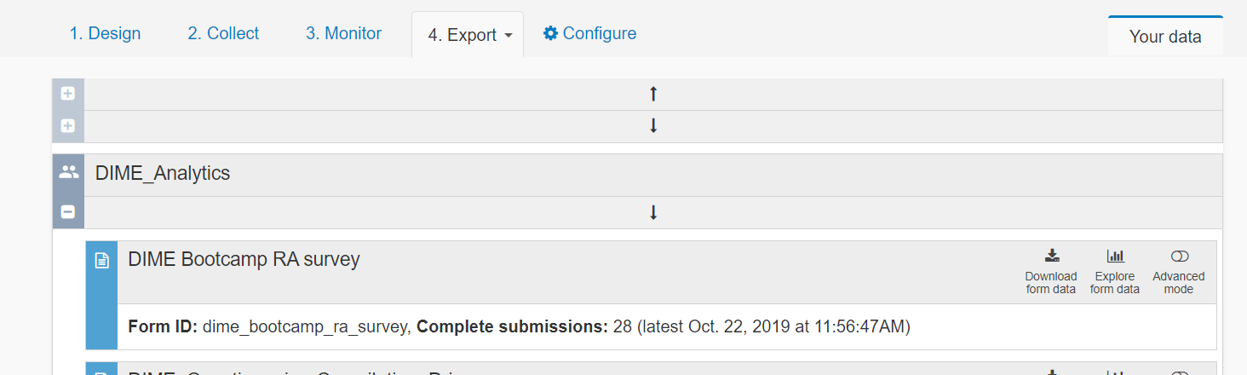
Downloading data
Tab to use: Export
Can publish certain fields directly to Google Sheets

Slide 12
Downloading data using SurveyCTO desktop
A more efficient way to download data from the server is using SurveyCTO Desktop
New improved data export solution from SurveyCTO
SurveyCTO Desktop is new to v2.6 and replaces SurveyCTO Sync
Install SurveyCTO Desktop here

Slide 13
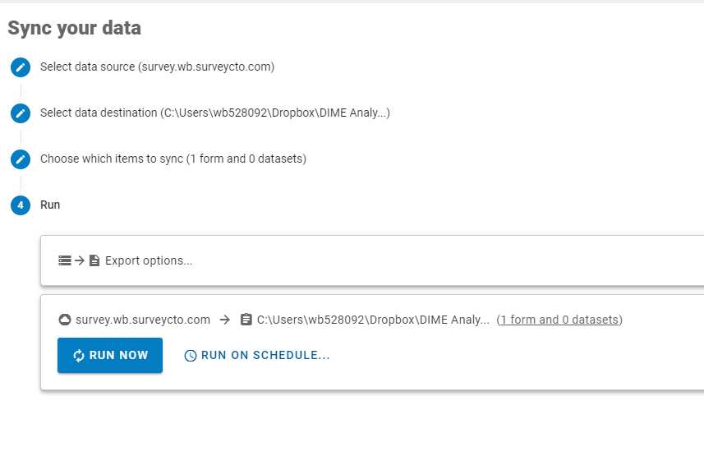
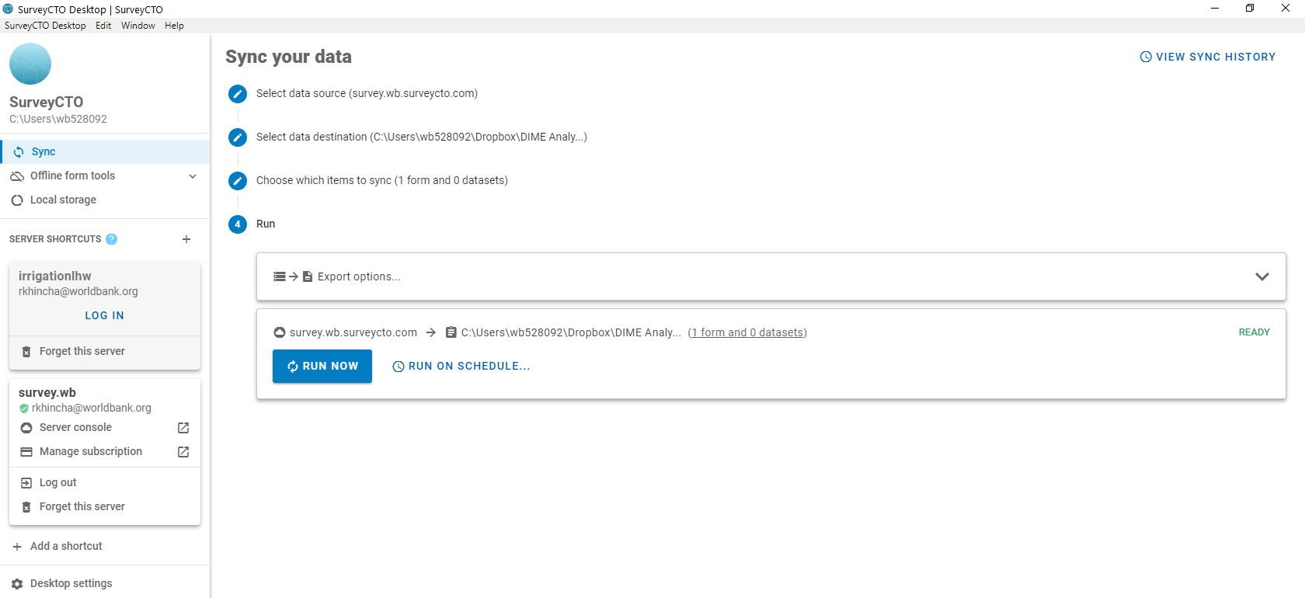
SurveyCTO Desktop

Slide 14
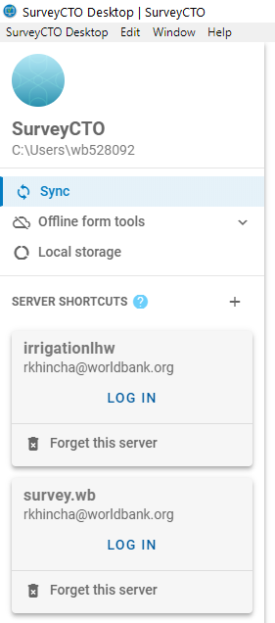
Benefits of SurveyCTO Desktop
Multiple servers in same location
Schedule data downloads
Auto-run processes after data download such as
Import & append do file
High frequency checks

Slide 15
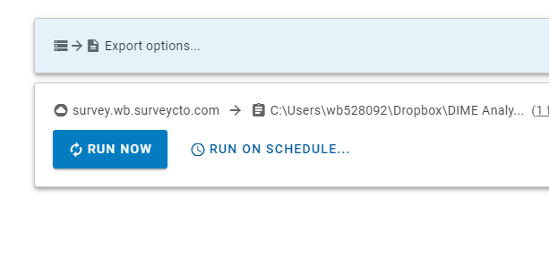
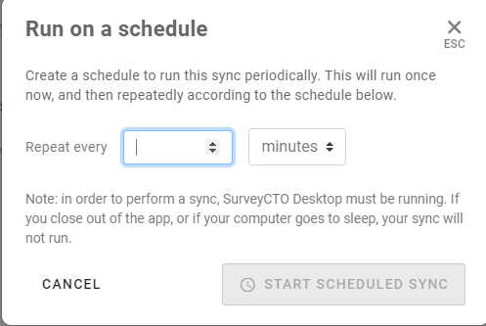
Benefits of SurveyCTO Desktop
Multiple servers in same location
Schedule data downloads
Auto-run processes after data download such as
Import & append do file
High frequency checks

Slide 16
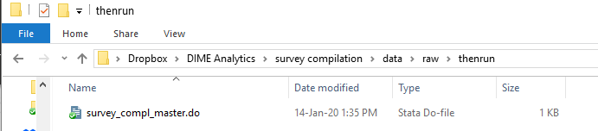
Benefits of SurveyCTO Desktop
Multiple servers in same location
Schedule data downloads
Auto-run processes after data download such as
Import & append do file
High frequency checks
Requires creating a folder titled ‘thenrun’ in the data export location which contains a do file to run.

Slide 17
Closing/extending a server
Server closure reminder email ~1 week prior to closing date
2 possible options for next steps
Extend the server
Close the server
Re-submit a new e-services request with
Same server name
New start date = End date of old server request
Reply to the closure reminder email
Create a copy on local computer and delete all forms and data from the server
Else the team will be charged for another month of server time
Remember to upload a copy of the each questionnaire to the Questionnaire library in DIME Team

Slide 18
Points of contacts for questions
SurveyCTO support
Technical questions about coding forms
Note that you reach out to the support center only when you have a paid server
DIME Analytics
Admin questions about the server setup

Slide 19
Thank you!

